Slide 1
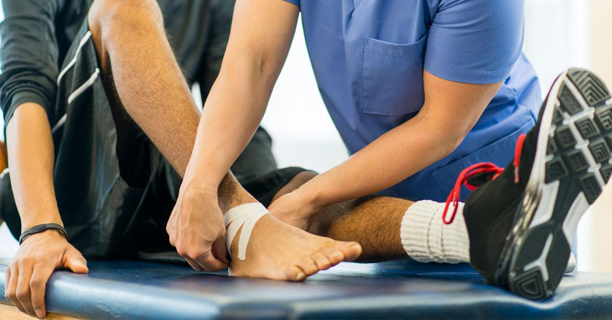
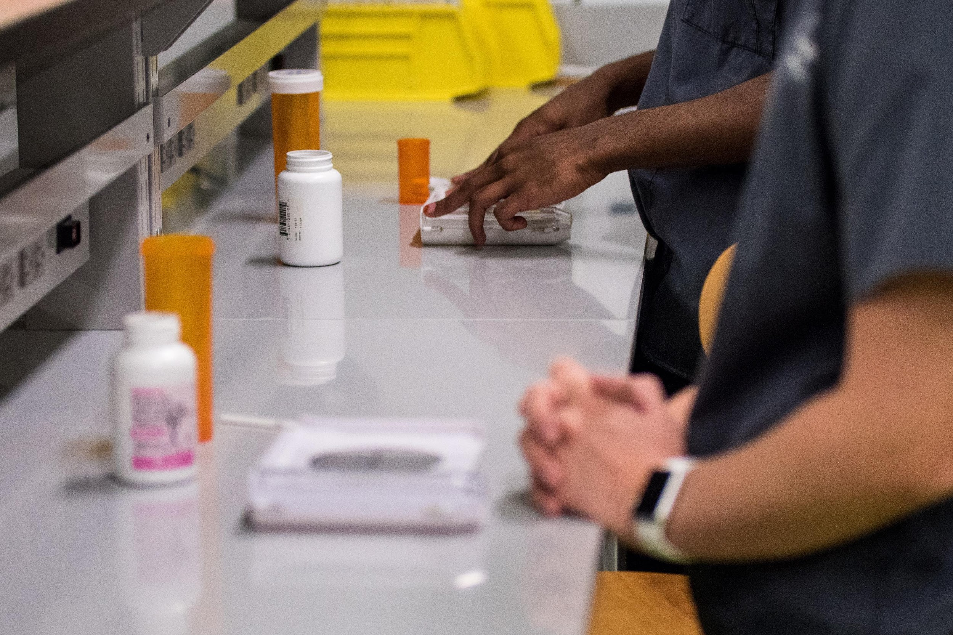
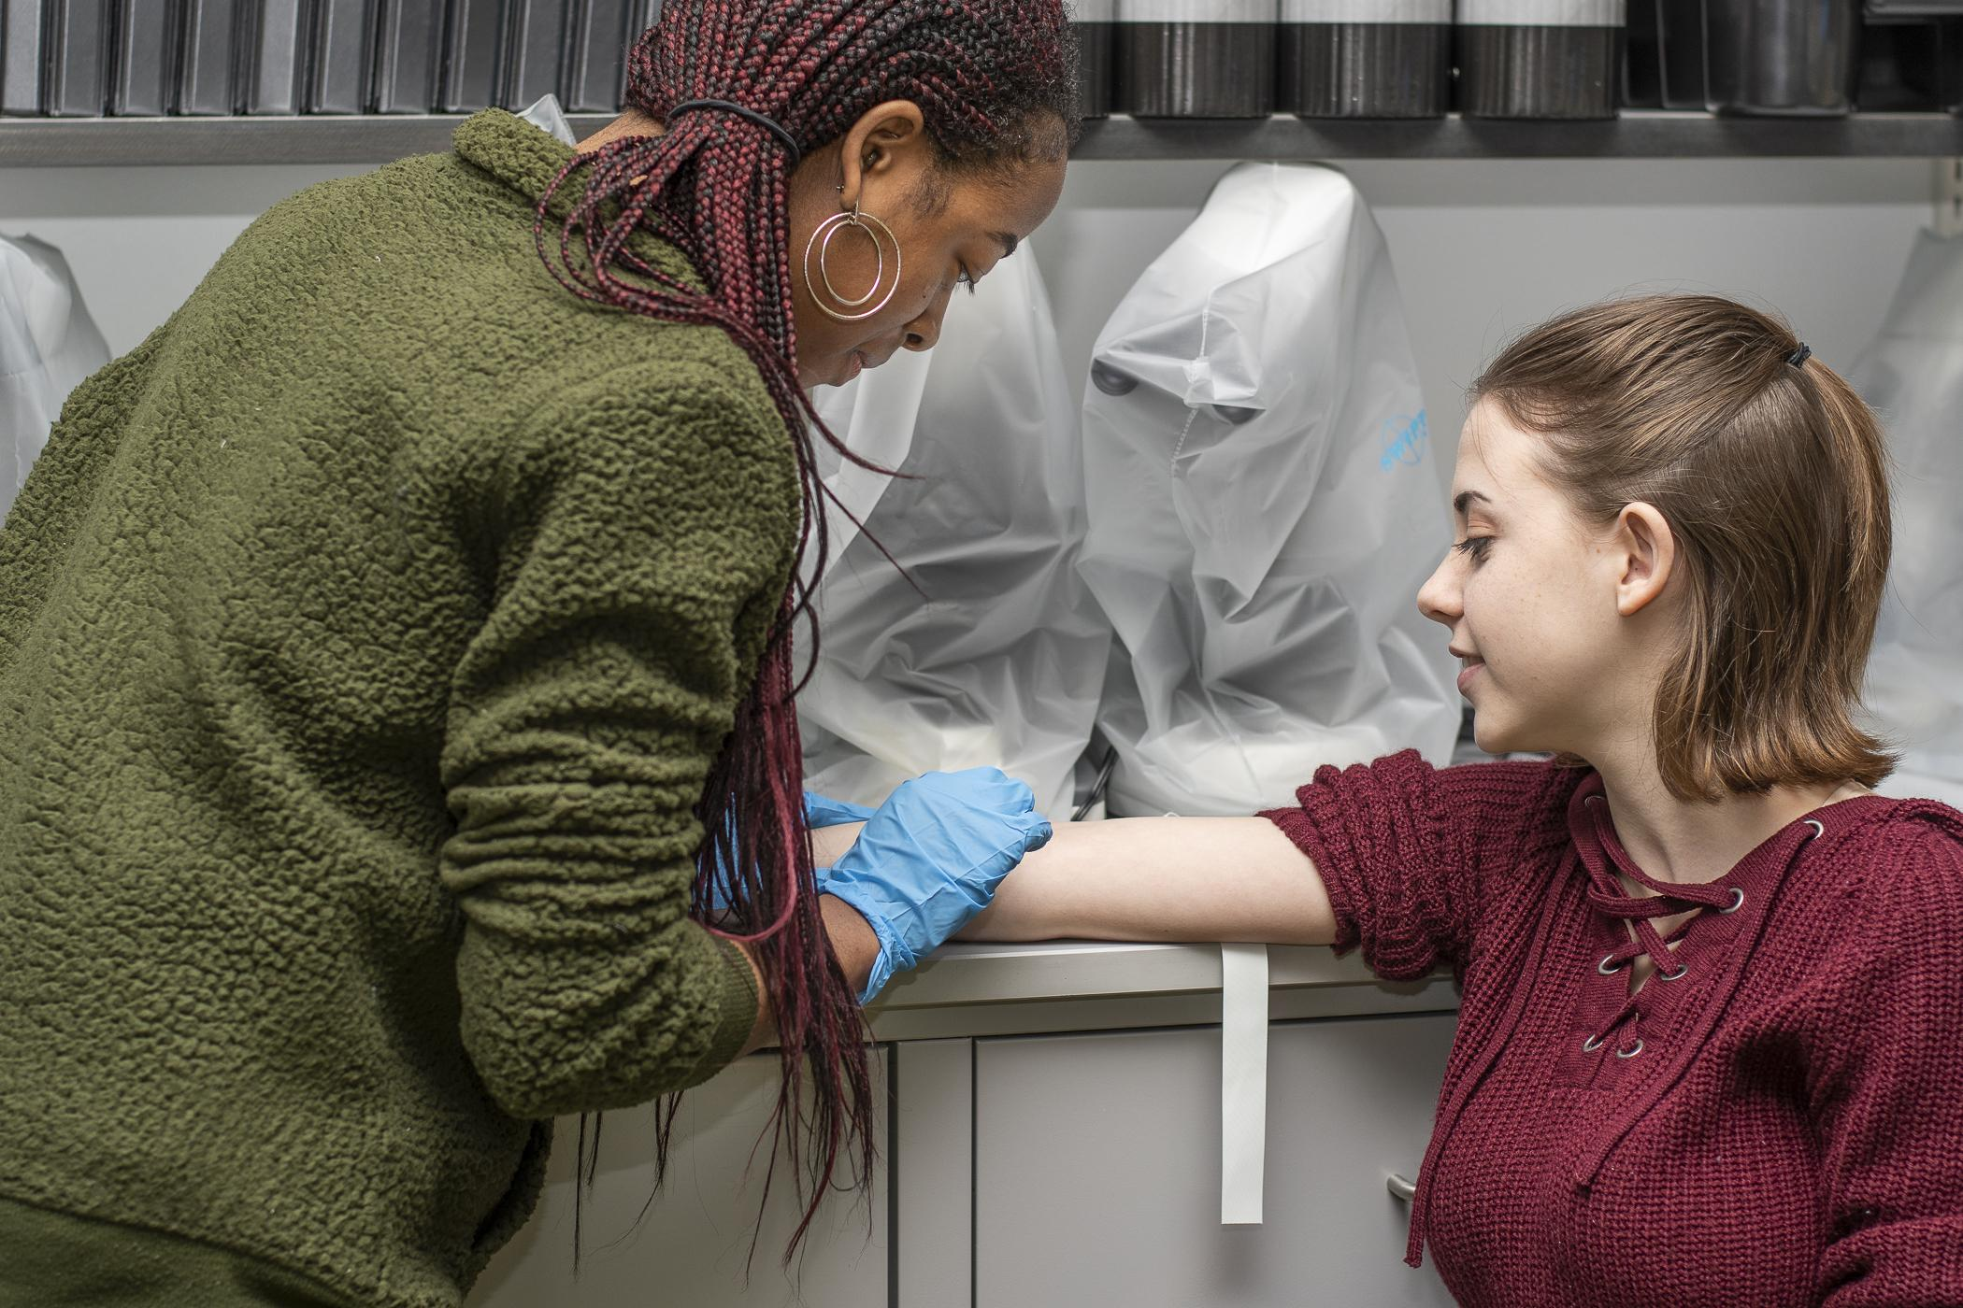
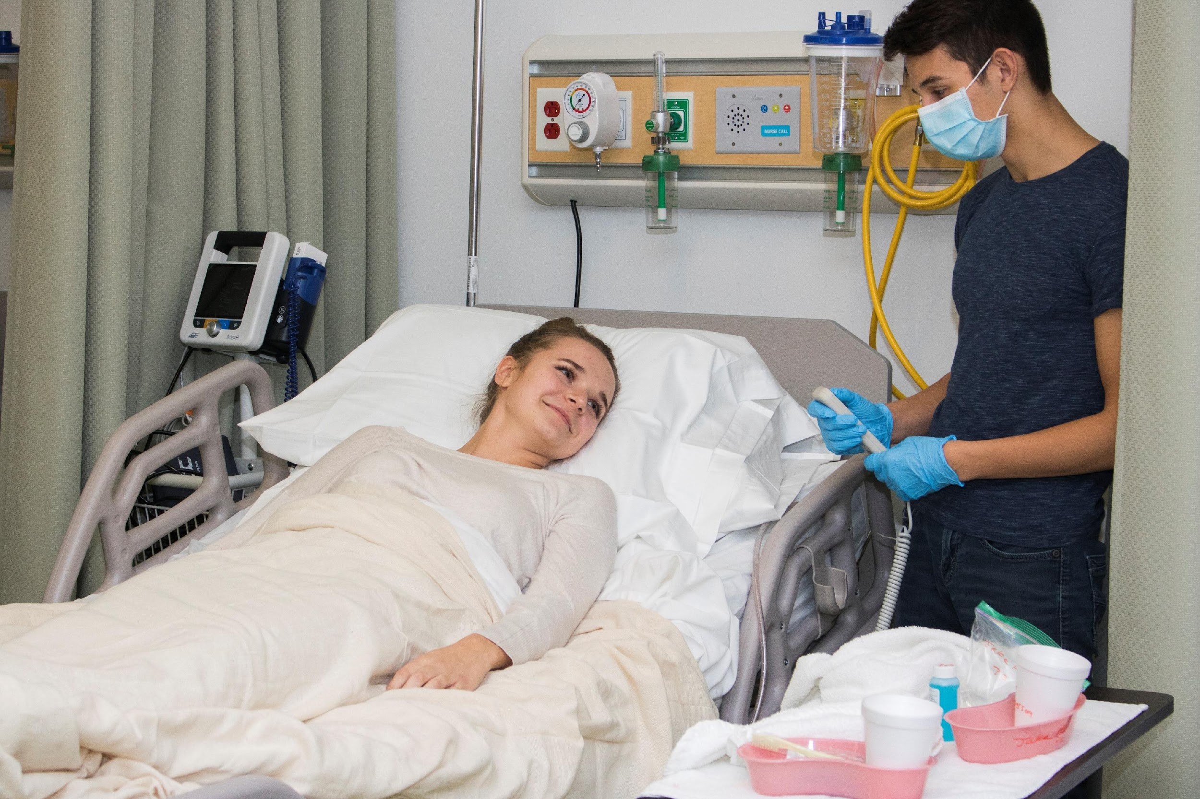
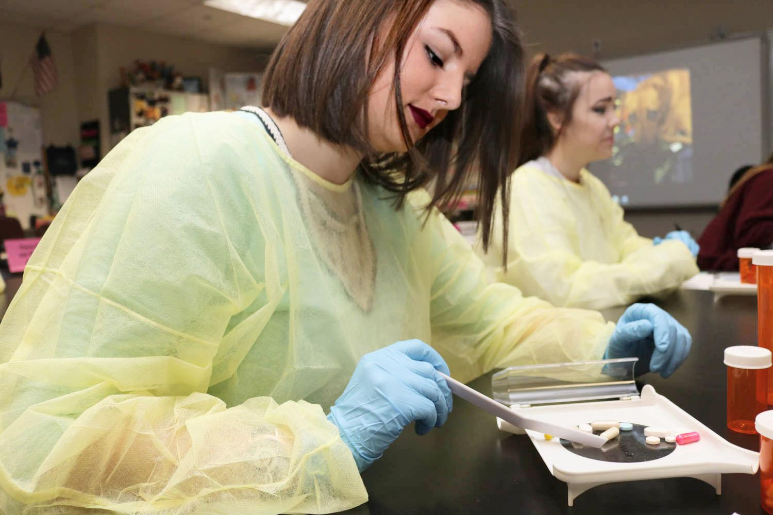
KELLER ISD HEALTH SCIENCE PROGRAMS 2024-2025

Slide 2
PROGRAM OPTIONS AND OVERVIEW
For Juniors and/or Seniors | For Seniors Only
Certified Nursing Assistant Practicum *CNA Practicum and A&P | Medical Assistant Practicum *Must have completed at least one of the following courses: Clinical Rotations, Certified Nursing Assistant, Pharmacology, Pathophysiology, Medical Microbiology, Kinesiology II
Clinical Rotations Practicum *Clinical Rotations Practicum and A&P | Patient Care Technician Practicum *Must have completed at least one of the following courses: Clinical Rotations, Certified Nursing Assistant, Pharmacology, Pathophysiology, Medical Microbiology, Kinesiology II
PRE - Pharmacy Technician *Pharmacology and A&P | Pharmacy Technician Practicum *Must have completed pharmacology in 11th grade
PRE - Emergency Medical Technician *Pathophysiology and A&P | Emergency Medical Technician Practicum *Pathophysiology must be taken as a prereq or a coreq
PRE - Medical Lab Assistant *Medical Microbiology and A&P | Exercise Science & Sports Medicine Practicum *Must have completed Kinesiology II in 11th grade
Exercise Science and Sports Medicine *Kinesiology II and A&P | Medical Lab Assistant Practicum *Must have completed Medical Microbiology
Pathway Electives
Anatomy and Physiology
Pathophysiology
Pharmacology
Medical Microbiology
Kinesiology I
Kinesiology II *Must have completed Kinesiology I

Slide 3
CERTIFIED NURSING ASSISTANT (CNA)
A Certified Nursing Assistant helps nurses in medical facilities by giving basic care to patients. This type of care is vital in hospitals, long-term care facilities, and in-home health care environments. Duties often include helping patients with feeding and bathing, checking vital signs, and providing assistance with basic healthcare needs. In addition, Certified Nursing Assistants must also be able to offer encouragement and emotional support to their patients. Certified Nursing Assistants—also known as Nursing Aides—have an enormous impact on the day-to-day experience of the patients, helping them feel cared for and capable as they face medical challenges. Certified Nursing Assistants have become more respected over the years as it has become more obvious how important this type of care is. We highly recommend this course for students interested in pursuing any type of nursing career beyond high school.
Item | Cost
CNA Exam | $125
Cord/Pin | $20
Scrubs (2 pair) | $100
TB Test | $50
Flu Vaccine | Typically free
CNA Workbook | $20
FAQ for this course | Answer
Am I required to have reliable transportation? | Yes, by November 1, 2024
Is there a certification for this class? | Yes, Certified Nursing Assistant
Is there a clinical requirement? | Yes, 40 hours in a long-term care facility
Informational video: | https://youtu.be/n_lkbb9Z4J8
What grade level is this course designed for? | 11th or 12th
If I take this course in 11th grade, what are my options in 12th grade? | PCT, MA, or any combination of health science electives
Program of Study Course Sequence | 9th Grade | 10th Grade | 11th Grade | 12th Grade
Health Science: Certified Nursing Assistant (CNA) | Medical Terminology (1 credit) | Health Science Theory (1 credit) | Anatomy and Physiology (1 credit) AND Practicum in Health Science I: CNA (2 credits) | Practicum in Health Science II: PCT (2 credits) OR Practicum in Health Science II: CMA (2 credits)

Slide 4
CLINICAL ROTATIONS
Do you know you want to go into the medical field but aren’t quite sure which area to pursue? If so, clinical rotations might be the perfect fit for you. Students will have the opportunity to do rotations at a hospital to observe the different specialties, or might get to intern at a dentist, optometrist, pediatrician, physical therapist, or other type of doctor’s office. Practicum students will split their time between the classroom and the clinical facility.
Item | Cost
Drug Screen | $45
TB Test | $50
Scrubs (2 pair) | $100
Flu Vaccine | Typically free
FAQ for this course | Answer
Am I required to have reliable transportation? | Yes, by September 1, 2024
Is there a certification for this class? | No
Is there a clinical requirement? | Yes, the entire course is dedicated to clinical rotations
Informational video: | https://youtu.be/CnTRGf7oyZc
What grade level is this course designed for? | 11th or 12th
If I take this course in 11th grade, what are my options in 12th grade? | PCT, MA, or any combination of Health Science electives
Program of Study Course Sequence | 9th Grade | 10th Grade | 11th Grade | 12th Grade
Health Science: Clinical Rotations | Medical Terminology (1 credit) | Health Science Theory (1 credit) | Anatomy and Physiology (1 credit) AND Practicum in Health Science I: Clinical Rotations (2 Credits) | Practicum in Health Science II: PCT (2 credits) OR Practicum in Health Science II: CMA (2 credits)

Slide 5
EMERGENCY MEDICAL TECHNICIAN (EMT)
Calling all future paramedics or EMTs or anyone that has an interest in becoming an Emergency Physician, Trauma Surgeon or Emergency Room or ICU Nurse. In this pathway, you will learn emergency medical information related to signs/symptoms of trauma and its assessment, patient care skills, and appropriate treatment of emergent medical conditions. If you successfully complete the class, clinicals/ride alongs, and pass the National Registry exam, you would be eligible to work as an EMT right out of high school. The EMT program could be a step to becoming a firefighter/paramedic and is also good for someone who likes a challenge. KCAL will only have 26 seats (for seniors only) in the EMT Practicum for the 24-25 school year. Junior students are in the Pre-EMT classes (Patho and A&P) so that they may have a solid base for this challenging class.
EMT Practicum Fees | Cost
Uniform | $125
Drug Screen | $10
TB Test | $30
EMT Exam and Fees | $160
Liability Insurance | $50
Fingerprinting | $45
FAQ for this course | Answer
Am I required to have reliable transportation? | Yes, by December 1, 2024 (Weekends/holidays only)
Is there a certification for this class? | Yes, Emergency Medical Technician
Is there a clinical requirement? | Yes, 36 hours in ER and 42 hours in ambulance
Informational video: | https://youtu.be/4_ei2cINlJg
What grade level is this course designed for? | The practicum is only for 12th graders; 11th graders are enrolled in A&P and Pathophysiology
If I take pathophysiology in 11th grade, what are my options in 12th grade? | EMT Practicum, MA, PCT, or any combination of health science electives
Program of Study Course Sequence | 9th Grade | 10th Grade | 11th Grade | 12th Grade
Health Science: Emergency Medical Technician (EMT) | Medical Terminology (1 credit) | Health Science Theory (1 credit) | Anatomy and Physiology (1 credit) AND Pathophysiology (1 credit) | Practicum in Health Science I: EMT (2 credits) OR Practicum in Health Science II: PCT (2 credits) OR Practicum in Health Science II: CMA (2 credits)

Slide 6
PHARMACY TECHNICIAN (CPHT)
The pharmacy industry is evolving. Many clinical duties have been extended to the pharmacy, which expands the role of both pharmacist and pharmacy technician. According to NHA's 2020 Industry Outlook, 40% of employers said pharmacy technicians have more responsibilities this year than last! Pharmacy technicians play a crucial role in providing safe and effective patient care, with duties including:
Managing inventory
Receiving prescription requests from patients and doctors' offices
Accurately measuring medication amounts
Establishing and maintaining patient records
Accepting payment for prescriptions and processing insurance claims
Item | Cost
CPhT Exam | $129
SPAT Exam | $250
Scrubs (2 pair) | $100
Drug Screen | $45
TB Test | $50
Flu Vaccine | Typically free
License and Fingerprinting | $100
FAQ for this course | Answer
Am I required to have reliable transportation? | Yes, by October 1, 2024, in order to participate in clinicals
Is there a certification for this class? | Yes, Certified Pharmacy Technician AND Sterile Processing & Aseptic Technique
Is there a clinical requirement? | Not required but highly recommended
Informational video:
What grade level is this course designed for? | The practicum is only for 12th graders; 11th graders are enrolled in A&P and Pharmacology
If I take pharmacology in 11th grade, what are my options in 12th grade? | Pharmacy Practicum, PCT, MA, or any combination of health science electives
Program of Study Course Sequence | 9th Grade | 10th Grade | 11th Grade | 12th Grade
Health Science: Pharmacy | Medical Terminology (1 credit) | Health Science Theory (1 credit) | Anatomy & Physiology (1 credit) AND Pharmacology (1 credit) | Practicum in Health Science I: Pharmacy (2 credits), OR Practicum in Health Science II: PCT (2 credits) OR Practicum in Health Science II: CMA (2 credits)

Slide 7
EXERCISE SCIENCE AND SPORTS MEDICINE
Find your niche in the health and wellness arena. This pathway is for students interested in future careers that provide a service to help others with their overall health and wellness such as: athletic trainer, personal trainer, physical therapist, nutritionist, orthopedic surgeon, coaches. Students obtain their First Aid and CPR certification and learn about the body's development, dynamic movement, injuries, nutrition, strength and conditioning through interactive labs and activities.
Item | Cost
Certification Exam | $249
Certification Prep Materials | $0
Uniform | $25-$100
TB Test | $50
Flu Vaccine | Typically Free
FAQ for this course | Answer
Am I required to have reliable transportation? | Yes, by September 1, 2024, in order to participate in clinicals
Is there a certification for this class? | Yes, Certified Personal Trainer
Is there a clinical requirement? | Yes, students will have the opportunity to intern at related medical offices (dependent on clinic availability)
Informational video:
What grade level is this course designed for? | The practicum course is only for 12th graders; 11th graders will take the Kinesiology II course
If I take Kinesiology II in 11th grade, what are my options in 12th grade? | Sports Medicine Practicum, MA, PCT, or any combination of health science electives
Program of Study Course Sequence | 9th Grade | 10th Grade | 11th Grade | 12th Grade
Health Science: Exercise Science and Sports Medicine | Medical Terminology (1 credit) | Health Science* Theory (1 credit) AND Kinesiology I* (1 credit) | Anatomy and Physiology (1 credit) AND Kinesiology II (1 credit) | Practicum in Health Science I: Exercise Science (2 credits), OR Practicum in Health Science II: PCT (2 credits) OR Practicum in Health Science II: CMA (2 credits)
*Students fully committed to the Exercise Science pathway as their program of study can opt to only take Kinesiology I during their 10th grade year. Students wanting to keep their options open for other health science programs should take Health Science theory and Kinesiology I in 10th grade.

Slide 8
MEDICAL LAB ASSISTANT
Medical Laboratory Assistants are healthcare professionals who can be found working both on the frontlines and behind the scenes. Medical Lab Assistants typically work in lab settings such as those within a hospital, physician’s office, or urgent care facility. The work they do is important for both patients and the healthcare field overall. Their duties may include:
Drawing blood from patients (also called phlebotomy)
Properly labeling and handling samples ahead of lab tests
Preparing lab equipment for tests and research
Using various pieces of lab equipment such as microscopes
Performing lab tests
Reporting test results to doctors or other healthcare personnel
Required Prerequisite Course: Medical Microbiology
Item | Cost
Scrubs (2 pair) | $100
CPT Exam Prep Materials | $0
CPT Exam | $125
Cords/Pins | $25
FAQ for this course | Answer
Am I required to have reliable transportation? | No
Is there a certification for this class? | Yes, Certified Phlebotomy Technician
Is there a clinical requirement? | No
What grade level is this course designed for? | 12th
Program of Study Course Sequence | 9th Grade | 10th Grade | 11th Grade | 12th Grade
Health Science: Medical Lab Assistant | Medical Terminology (1 credit) | Health Science Theory (1 credit) | Medical Microbiology (1 credit) AND Anatomy and Physiology (1 credit) | Practicum in Health Science : Medical Lab Assistant, OR Practicum in Health Science II: PCT (2 credits) OR Practicum in Health Science II: CMA (2 credits)

Slide 9
CLINICAL MEDICAL ASSISTANT (CCMA)
Medical assistants (MAs) are critical members of healthcare teams in a variety of medical settings. As an MA, you are often the first and last person a patient interacts with, making a lasting impact on the patient experience. MAs are flexible, performing a variety of tasks such as:
Taking patient vital signs
Basic Patient Care
Assisting providers with exams and procedures
Administering injections or medications
Performing EKG, phlebotomy and other essential laboratory procedures
Checking patients in and out upon arrival and departure
Answering phone calls and questions
Updating and maintaining electronic health records (EHR)
Required Prerequisite Options: Must have completed at least one of the following courses: Clinical Rotations, Certified Nursing Assistant, Pharmacology, Pathophysiology, Medical Microbiology, or Kinesiology II
Item | Cost
MA Exam | $160
MA Exam Prep Materials | $0
Scrubs (2 pair) | $100
Stethoscope | $10
Cords/Pins | $25
Drug Screen | $45
TB Test | $50
FAQ for this course | Answer
Am I required to have reliable transportation? | Yes, by January 1, 2025, in order to participate in clinicals
Is there a certification for this class? | Yes, Certified Clinical Medical Assistant
Is there a clinical requirement? | Not required, but highly recommended
Informational video: | https://youtu.be/Irpuqx5Py1E
What grade level is this course designed for? | 12th

Slide 10
PATIENT CARE TECHNICIAN (PCT)
Doctors, nurses and other healthcare professionals rely on patient care technicians to assist with the critical day-to-day care some patients require. They provide hands-on assistance to serve patients' basic needs, which greatly impacts the lives of their patients and their patients' families. As a patient care tech, you may be able to perform some or all of the following tasks:
Provide basic patient care — bathing, feeding, catheter care, etc.
Acquire, distribute and administer patient care supplies
Perform safety checks and ensure cleanliness in patient rooms
Accommodate any additional patient needs
Obtain EKG readings and monitor vital signs
Perform phlebotomy procedures
Provide emotional support to patients and families, particularly coping with grief and death
Required Prerequisite Options: Must have completed at least one of the following courses: Clinical Rotations, Certified Nursing Assistant, Pharmacology, Pathophysiology, Medical Microbiology, or Kinesiology II
Item | Cost
PCT Exam | $160
PCT Exam Prep Materials | $0
Scrubs (2 pair) | $100
Cords/Pins | $25
Drug Screen | $45
TB Test | $50
FAQ for this course | Answer
Am I required to have reliable transportation? | Yes, by January 1, 2025, in order to participate in clinicals
Is there a certification for this class? | Yes, Patient Care Technician
Is there a clinical requirement? | Not required, but highly recommended
Informational video: | https://www.youtube.com/watch?v=Kt27RDHKIUA
What grade level is this course designed for? | 12th

Slide 11
COURSE REQUEST PROCESS
In order to be eligible for any of the 11th or 12th grade health science programs, you are required to complete this course request process. All students will be placed into a health science program but may not receive their 1st or 2nd choice program due to limited availability of these popular programs.
Steps to submit your course request
Complete the YouTube video and short answer essay
3 Teacher Recommendations
You must have three teachers complete the teacher recommendation Google Form by Jan 31, 2024.
It is your responsibility to ensure teachers get the link and complete the form.
A periodic update of completed recommendations will be sent to your Health Science teacher.
Complete Student Course Request Google Form (Deadline: January 31, 2024)
Complete interview (if needed; program dependent) in February
More details to come at a later date
Links and Resources
Student Course Request Form: https://forms.gle/h9daZf3MhS2Kg85KA
Teacher Recommendation Form: https://forms.gle/HZSbheuSDVAg86Jx6
Scoring Rubric: Spring 2024 Health Science Scoring Rubric.pdf
Contact Information
For questions or assistance please reach out to your Health Science teacher or the CTE Coordinator for Health Science, Debby Schneemann, at debra.schneemann@kellerisd.net or 817-743-8043

